Slide 1
Autism Awareness
Parent workshop 01.04.19

Slide 2
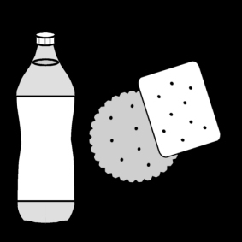
Housekeeping

Slide 3
Aims
To understand the four key areas of difference
To know some behaviours that may be seen
To be aware of strategies and resources used to support in school
To have a bank of ideas for use out of school
To be aware of organisations and websites that can offer support

Slide 4
Broad Area of Need
Communication and interaction
6. 29 Children and young people with ASD, including Asperger’s Syndrome and Autism, are likely to have particular difficulties with social interaction. They may also experience difficulties with language, communication and imagination, which can impact on how they relate to others.
SEND CoP 2015 (DfE)
Notes:
Within the SEND CoP 2015 Autism (referred to as ASD or ASC) and social interaction needs come under the broad heading of communication and interaction.
National Autistic Society define Autism as:
Autism is a lifelong disability which affects how people communicate and interact with the world. There are approximately 140,000 autistic school children in the UK .
1/100 children estimated to have Autismi i.e. in a school the size of TGPS that is 4 children (exactly the amount diagnosed). There may be others undiagnosed, with traits or a little on the spectrum. Also there will be children who display some of the differences due to developmental needs or emotional needs.
Diagnosis can be important in getting right the support, however the label does not change the child. How we support the child to be successful and happy is paramount.
At Turves Green we support each child’s differences whether a label is there or not.

Slide 5
Four Key Areas of Difference
Notes:
Every child is different. However the National Autistic Society have found that most children with Autism will suffer with high levels of anxiety and the cause may be rooted in their differences – how they see the world differently. It is important to remember that the children may well have abilities and excel in one of the four areas also. Every child is unique.

Slide 6
Interacting
What behaviours might you see if a child has differences with interacting?
In School, some examples of how we support include:
Interventions i.e. Socially Speaking
Social Stories: Social stories.ppt
Comic Strip Conversations: Comic Strip Conversations.ppt
Lunch club/ named support
Which of these could you try at home?
Notes:
Behaviour examples: invading personal space, not interested in others’ topics, lack of small talk, over-talking/ not aware of listeners needs, no eye contact, lack of awareness of social cues, not understanding the reasons behind others’ actions/ interactions.
Can also be developmental i.e. learning the different skills needed in different environments – we support this too! Also may be shy!
Pass around social story examples.

Slide 7
Sensory Processing
What behaviours might you see if a child has sensory differences?
In School, some examples of how we support include:
Sensory checklist and strategies
Sensory equipment
Transitioning at different times to avoid noise/ crowds
Which of these could you try at home?
Notes:
Behaviours: avoid certain clothes/ textures, like close hugs, avoid crowded places, rocking, doesn’t like loud noises, avoids or really seeks out strong tastes…
Be aware: I don’t like the texture of peaches due to the skin and I also feel very anxious in large groups – that doesn’t mean I have ASC.
Sensory checklist – pass around. Read some example strategies that could be tried at home.
Show sensory bag – discuss lots available in Works, Poundland, online etc

Slide 8
Communication
What behaviours might you see if a child has communication differences?
In School, some examples of how we support include:
Widgits/ symbols/ pictures/ photos
Language awareness: Short, clear instructions, awareness of literal interpretations, avoid sarcasm etc.
Brometers/ flow charts/ signs/ prompt cards
Which of these could you try at home?
Notes:
Behaviours: unable to talk, struggles to communicate needs and wants (frustration), struggles to understanding what others mean by their use of language etc
Widgits: show examples from school
Barometers/ prompt cards: show examples from school
Discuss language use – also appropriate for lots of children so that they know clearly what to expect.

Slide 9
Processing Information
What behaviours might you see if a child has processing differences?
In School, some examples of how we support include:
Linking learning to interests/ time to talk about interests
Support for changes to routine
Notes:
Behaviours: obsessed with topics/ interests, short attention, learn in a set way

Slide 10
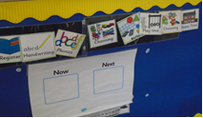
Supporting change
Now & Next boards:
Pre-warning
Visual timetables
Transition books:
Example transition book for CPD.ppt
Notes:
Pre-warnings using visual and auditory cues. Lots of praise. All children don’t want to stop doing something they enjoy so a good strategy for all children.

Slide 11
Processing Information
What behaviours might you see if a child has processing differences?
In School, some examples of how we support include:
Linking learning to interests/ time to talk about interests
Support for changes to routine
Task boards

Slide 12
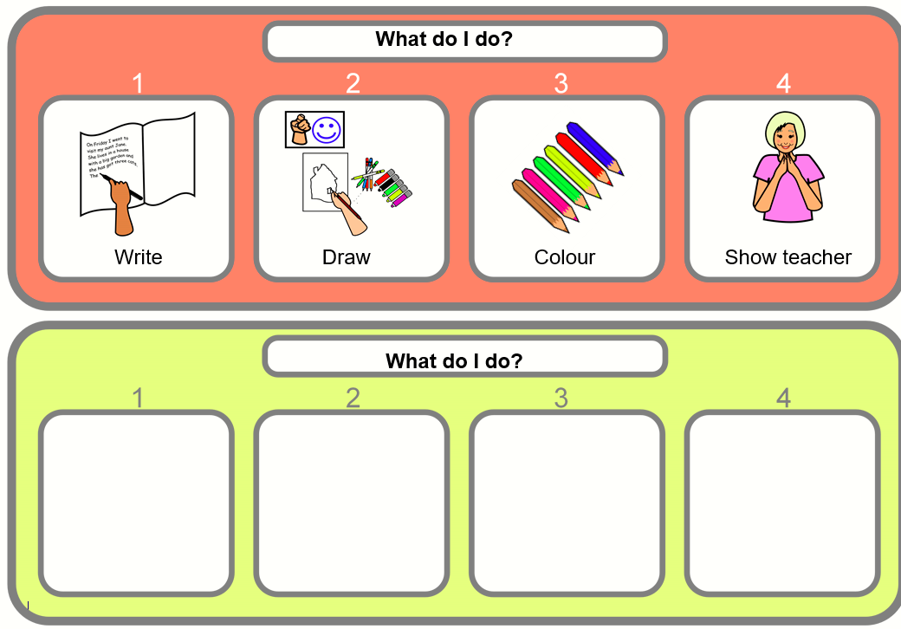
Task boards
How could this be adapted for home?
Notes:
Supports a start and end. Again useful for all children, especially when a task needs completing but the child wishes to be doing something different i.e. TV! Supports in the context of clear routines and boundaries.
Packs: widget symbols for home and different task board formats.

Slide 13
Processing Information
What behaviours might you see if a child has processing differences?
In School, some examples of how we support include:
Linking learning to interests/ time to talk about interests
Support for changes to routine
Task boards
Which of these could you try at home?

Slide 14
How will others’ know how to support my child?
One Page Profile MASTER.doc

Slide 15
Further reading
How to raise a happy autistic child -Jessie Hewitson
Understanding Autism: The essential guide for parents -by Katrina Williams and Jacqueline Roberts
Understanding Autism for Dummies Paperback- Stephen M Shore
“The Autistic Spectrum” Jill Boucher –(An introduction to autism and a source of basic information).
“The Survival Guide For Kids With Autism Spectrum Disorders (And Their Parents)” Elizabeth Verdick and Elizabeth Reeve, MD
“Autism Life Skills” Chantelle Sicile-Kira

Slide 16
Resources and Information
https://www.autismwestmidlands.org.uk/
https://www.autism.org.uk/
https://resourcesforautism.org.uk/
https://www.autismeducationtrust.org.uk/

Slide 17
Thank you!
I hope the resources in your packs are really useful!
Questions?
Notes:
Have a look at the resources and discuss which may be useful for your child. Are there any you’ll try in the next 24 hours?
I’ll also come around to answer any questions.

